Slide 2
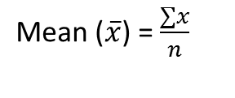
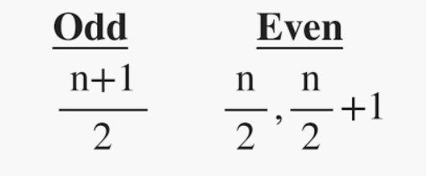
Mean: Calculate sum of all the values and divide it with the total number of values in the data set.
Where, n = number of terms
Median: The middle value of the data set.
Mode: The most occurring number in the data set. For calculating mode, there is no default function in R. So, we have to create our own custom function.

Slide 3
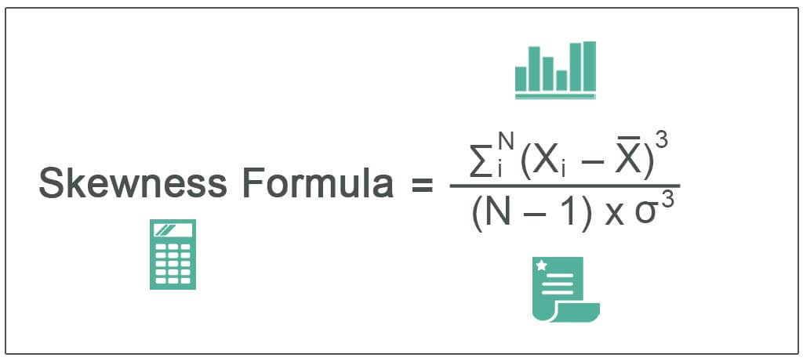
The term “skewness” refers to the statistical metric used to measure the asymmetry of a probability distribution of random variables about its mean. Its value can be positive, negative, or undefined.
The skewness equation is calculated based on the mean of the distribution, the number of variables, and the standard deviation of the distribution.
Mathematically, the skewness formula represents,
where
X_{i} = i^{th} Random Variable
X= Mean of the Distribution
N = Number of Variables in the Distribution
Ơ = Standard Distribution

Slide 4
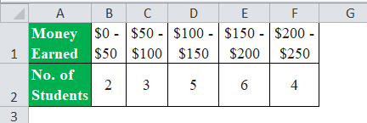
Let us take the example of a summer camp in which 20 students assign certain jobs that they performed to earn money to raise funds for a school picnic. However, different students earned different amounts of money. Based on the information given below, determine the skewness in the income distribution among the students during the summer camp.
Solution:
The following is the data for the calculation of skewness.

Slide 5

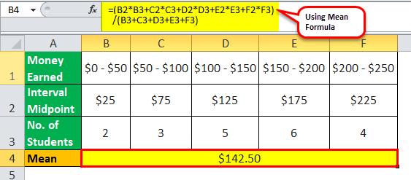
Number of variables, n = 2 + 3 + 5 + 6 + 4= 20
Let us calculate the midpoint of each of the intervals.
($0 + $50) / 2 = $25
($50 + $100) / 2 = $75
($100 + $150) / 2 = $125
($150 + $200) / 2 = $175
($200 + $250) / 2 = $225
Now, one can calculate the mean of the distribution as,
Mean= ($25 * 2 + $75 * 3 + $125 * 5 + $175 * 6 + $225 * 4) / 20
Mean = $142.50

Slide 6

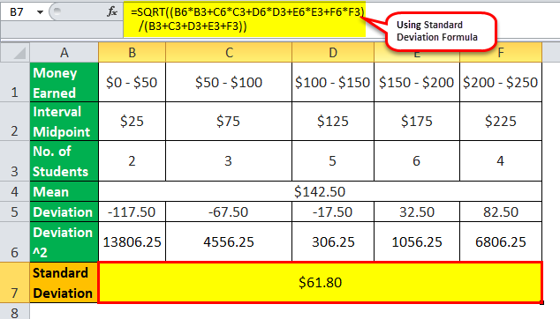
One can calculate the squares of the deviations of each variable as below,
($25 – $142.5)² = 13806.25
($75 – $142.5)² = 4556.25
($125 – $142.5)² = 306.25
($175 – $142.5)² = 1056.25
($225 – $142.5)² = 6806.25
Now, one can calculate the standard deviation by using the below formula,
ơ = [(13806.25 * 2 + 4556.25 * 3 + 306.25 * 5 + 1056.25 * 6 + 6806.25 * 4) / 20]^{1/2}
ơ = 61.80

Slide 7

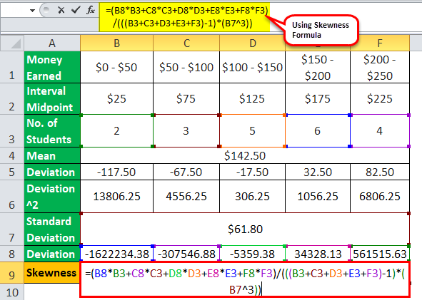
One can calculate the cubes of the deviations of each variable below,
($25 – $142.5)³ = -1622234.4
($75 – $142.5)³ = -307546.9
($125 – $142.5)³ = -5359.4
($175 – $142.5)³ = 34328.1
($225 – $142.5)³ = 561515.6
Therefore, the calculation of the skewness of the distribution will be as follows,
= (-1622234.4 * 2 + -307546.9 * 3 + -5359.4 * 5 + 34328.1 * 6 + 561515.6 * 4) /[ (20 – 1) * (61.80)³]

Slide 8
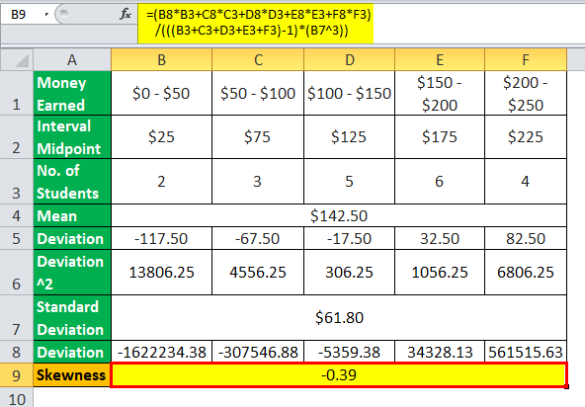
Skewness will be –
Skewness = -0.39

Slide 9
Kurtosis
The term “Kurtosis” refers to the statistical measure that describes the shape of either tail of a distribution, i.e. whether the distribution is heavy-tailed (presence of outliers) or light-tailed (paucity of outliers) compared to a normal distribution. In other words, it indicates whether the tail of distribution extends beyond the ±3 standard deviation of the mean or not.
There are three types of kurtosis that can be exhibited by any distribution:
Leptokurtic or heavy-tailed distribution (kurtosis more than normal distribution)
Mesokurtic (kurtosis same as the normal distribution)
Platykurtic or short-tailed distribution (kurtosis less than normal distribution)
The formula for kurtosis is expressed as the ratio of the fourth moment and variance (s²) squared or squared the second moment of the distribution. Mathematically, it is represented as,
Kurtosis = n * Σ^{n}_{i}(Y_{i} – Ȳ)⁴ / (Σ^{n}_{i}(Y_{i} – Ȳ)²)²
Where
Y_{i}: i^{th} Variable of the Distribution
Ȳ: Mean of the Distribution
n: No. of Variables in the Distribution

Slide 10
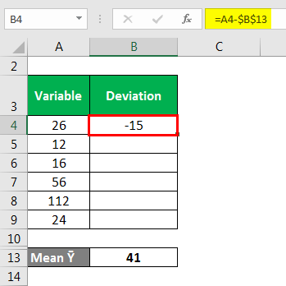
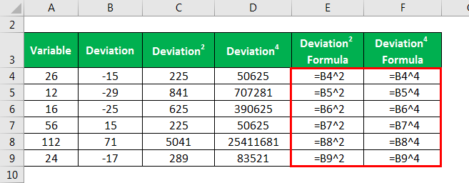
Let us take the example of the following data distribution to illustrate the computation of kurtosis of a leptokurtic distribution: 26, 12, 16, 56, 112, 24.
Mean Ȳ = (26 + 12 + 16 + 56 + 112 + 24) / 6
Mean Ȳ = 41
Standard Deviation is calculated as
Deviation² and Deviation⁴ is calculated as

Slide 11
Second Moment is calculated using the formula given below
Second Moment = Σ^{n}_{i}(Y_{i} – Ȳ)² / n
Second Moment = [(26 – 41)² + (12 – 41)² + (16 – 41)² + (56 – 41)² + (112 – 41)² + (24 – 41)²] / 6
Second Moment = 1207.67
Fourth Moment is calculated using the formula given below
Fourth Moment = Σ^{n}_{i}(Y_{i} – Ȳ)⁴ / n
Fourth Moment = [(26 – 41)⁴ + (12 – 41)⁴ + (16 – 41)⁴ + (56 – 41)⁴ + (112 – 41)⁴ + (24 – 41)⁴] / 6
Fourth Moment = 4449059.67
Kurtosis is calculated using the formula given below
Kurtosis = Fourth Moment / (Second Moment)²
Kurtosis = 4449059.667 / (1207.667)²
Kurtosis = 3.05

Slide 12


he null hypothesis is rejected ,hence there is enough evidence to support the teacher's claim at 0.05 significance level.
Given
standard deviation =20
sample size (n = 81)
mean(μ) = 90
To find:
If there is enough evidence to support the null hypothesis.
Solution:
The standard deviation is given and the sample size is 81 ,hence this distribution is right-tailed one-sample z test.
Let us consider the null and alternative hypothesis:
Using the z-table we can calculate the significance as
Now we have to find the z-score. Z-score is calculated using the formula:
, where ρ denotes the standard deviation .
Now we will use the above values to calculate the z-score.
Now we can see that , so we can reject the null hypothesis.
Therefore there is enough evidence in support of the teachers' claim at a 0.05 significance level.

Slide 13

Z-test is the statistical test used to analyze whether two population means are different or not when the variances are known, and the sample size is large.
The z-test is based on the normal distribution.
The assumptions for Z-test are:
All observations are independent.
The size of the sample should be more than 30.
The Z distribution is normal when the mean is 0, and the variance is 1.
The test statistic is defined by:
Xbar is the sample mean
σ is the population standard deviation
n is the sample size
μ is the population mean

Slide 14
Let's say that the mean score of students in a class is greater than 70 with a standard deviation of 10. If a sample of 50 students was selected with a mean score of 80, calculate the Z-value to check if there is enough evidence to support this claim at a 0.05 significance level.
Solution:
Here, the sample size is 50 and we know the standard deviation. This is a case of a right-tailed one-sample z test.
The Null hypothesis is the mean score is 70
The Alternative hypothesis is mean score is greater than 70
From the z-table, the critical value at alpha = 0.05 is 1.645
Xbar = 80
μ = 70
n = 50
σ = 10
Substituting the values in the formula, you will get the Z value to be equal to 7.09.
Since 7.09 > 1.645 thus, the null hypothesis is rejected and there is enough to support that the mean of the class is greater than 70.

Slide 15
Definition Of T-Test
A T-test is a parametric test applied to identify how the average of two data sets differs when variance is not given.
When the sample size is small, and the population standard deviation is unknown, the T-test is used in conjunction with the t-distribution. The degree of freedom significantly impacts the shape of a t-distribution. The number of independent observations in a given set of observations is the degree of freedom.
There are the following assumptions taken for the T-Test:
All the data points are independent.
The sample size is very small.
The sample size should be taken and recorded accurately.
Xbar is the sample mean
s is the sample standard deviation
n is the sample size
μ is the population mean

Slide 16
Example:
A store wants to improve its sales. The previous sales data shows that the average sale of 30 salesmen was $40 per sale. After some training, the current data showed an average sale of $60 per transaction. If the standard deviation given is $20, find the t-value. Did training improve the sales?
Solution:
Xbar = 60
s = 20
n = 30
μ = 40
Substituting the values in the formula, you will get t-value = 5.47. For the alpha value of 0.05, the critical value is 1.711. Here 5.47 > 1.711, we can reject the null hypothesis and conclude that training did affect sales.

Slide 17
Covariance is a measure of the relationship between two random variables and to what extent, they change together. Or we can say, in other words, it defines the changes between the two variables, such that change in one variable is equal to change in another variable. This is the property of a function of maintaining its form when the variables are linearly transformed. Covariance is measured in units, which are calculated by multiplying the units of the two variables.
Types of Covariance
Covariance can have both positive and negative values. Based on this, it has two types:
Positive Covariance
Negative Covariance
Positive Covariance
If the covariance for any two variables is positive, that means, both the variables move in the same direction.
Negative Covariance
If the covariance for any two variables is negative, that means, both the variables move in the opposite direction.

Slide 18
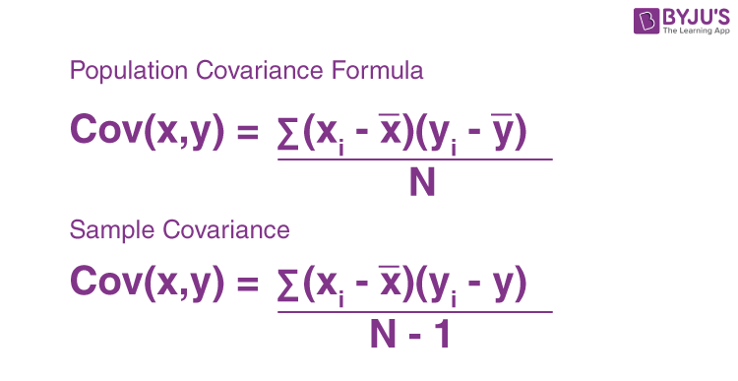
Where,
xi = data value of x
yi = data value of y
x̄ = mean of x
ȳ = mean of y
N = number of data values.

Slide 19
Correlation Coefficient Formula
We have already discussed covariance, which is the evaluation of changes between any two variables. Correlation estimates the depth of the relationship between variables. It is the estimated measure of covariance and is dimensionless. In other words, the correlation coefficient is a constant value always and does not have any units. The relationship between the correlation coefficient and covariance is given by;
Correlation,ρ(X,Y) = Cov(X,Y)/σ_{X} σ_{y}
Where:
ρ(X,Y) = correlation between the variables X and Y
Cov(X,Y) = covariance between the variables X and Y
σX = standard deviation of the X variable
σY = standard deviation of the Y variable

Slide 20
Covariance | Correlation
It is a measure to show the extent to which given two random variables change with respect to each other. | It is a measure used to describe how strongly the given two random variables are related to each other.
It is a measure of correlation. | It is defined as the scaled form of covariance.
The value of covariance lies between -∞ and +∞. | The value of correlation lies between -1 and +1.
It indicates the direction of the linear relationship between the given two variables. | It measures the direction and strength of the linear relationship between the given two variables.

Slide 21
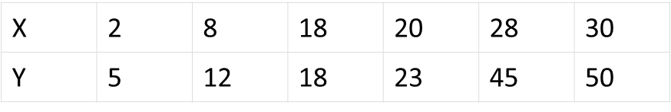
Question:
Calculate the coefficient of covariance for the following data:
Solution:
Number of observations = 6
Mean of X = 17.67
Mean of Y = 25.5
Cov(X, Y) = (⅙) [(2 – 17.67)(5 – 25.5) + (8 – 17.67)(12 – 25.5) + (18 – 17.67)(18 – 25.5) + (20 – 17.67)(23 – 25.5) + (28 – 17.67)(45 – 25.5) + (30 – 17.67)(50 – 25.5)]
= 157.83

